Slide 1

The Elevator Pitch
Richard M. Watanabe, Ph.D.
Depts of Population and Public Health Sciences
and
Physiology & Neuroscience
USC Diabetes and Obesity Research Institute

Slide 2
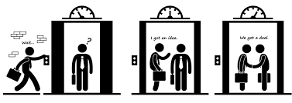
The Elevator Pitch
A brief, persuasive speech that you use to spark interest in:
An organization
A project or idea
Yourself
Why should you have an elevator pitch in your pocket?
Soliciting support (financial or otherwise)
Generating interest
Basic education
You never know who you’ll run into or where

Slide 3
The Elevator Pitch
Should generally consider two types of elevator pitches:
Brief 20−30 second pitch
Longer 2−3 minute pitch
Can also consider two broad perspectives in terms of your pitch:
Scientific
Public/layperson
General content for both types of pitches is the same
Basic background
What’s the problem?
Why is it important?

Slide 4
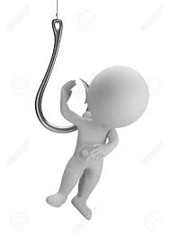
The Elevator Pitch
Pitching to a professional can save some time because:
Person you are talking to may be familiar with jargon
May already know aspects of you, your work, or your organization
Lay pitch has challenges as you may need additional time to:
Avoid jargon and explain stuff
Include important technical details
Same overall goals regardless of type of pitch
Attract the listener
Cover the basics
Get the main message across
“Hook” the person

Slide 5
The Elevator Pitch
Carefully consider why the person you are talking to should care
Always practice your pitch
PhD Comics Two Minute Thesis
https://www.youtube.com/playlist?list=PLhm1bauLfPNu2_IIXY-VrRNXz68Q03gpt

Slide 6

Example

Slide 7

Biostat Student Example

